Slide 1
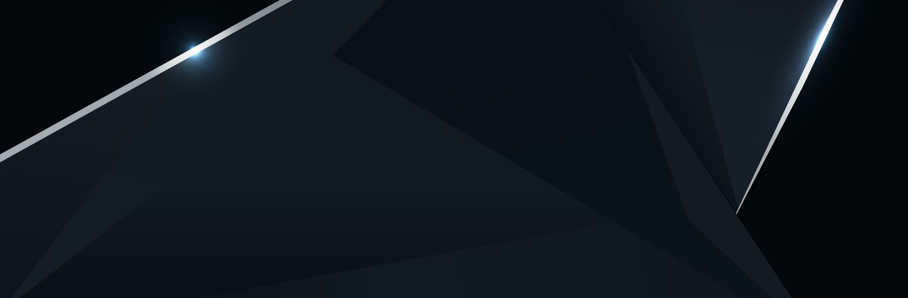
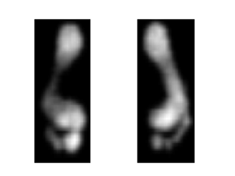
Time series Classification
Saeed Kazemi
15 April
Notes:
Hello everyone,
I am Saeed, our presentation is about Time series classification.

Slide 2
Presentation Contents
The problem and Dataset
Feature Extraction and Selection
Deep Learning Algorithm
Machine Learning Algorithm
Results and Discussion
Notes:
First,,,, let's look at the outlines.
In the first step,,,, we look at the problem as well as ,,,,, our Dataset
Afterward, we talk about features extracting,,,.
Then ,,,,,,,,,the Machine learning approaches as well as Deep neural networks are reviewed
and in the final,,,,, we gonna discuss about results.

Slide 3
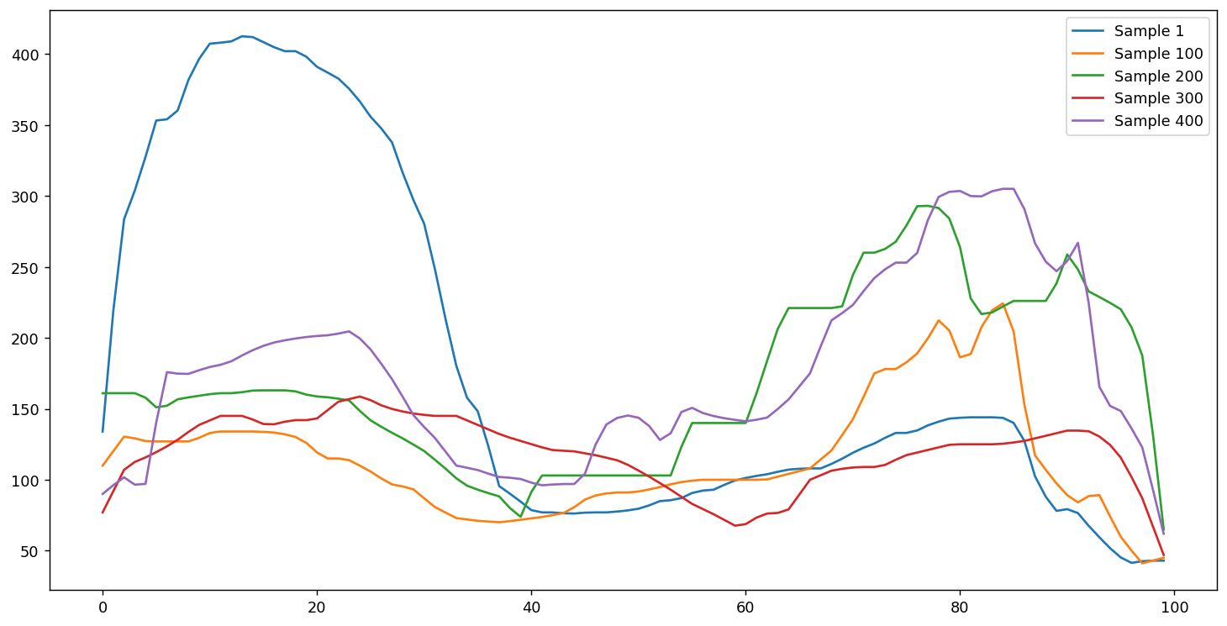
Describing the problem
Classification on time series data
Notes:
So let start,,,,,,,,,,,,,, The aim of this project is ,,,,,,,,,,,,,,,to do classification on time series data

Slide 4
The Dataset
Stepscan datasets was used in this project
Stepscan dataset is a video-based dataset.
Obtained from high resolution floor tiles.
1744 Samples * 200 frames * (80 * 60) images
80 subjects
Each subject has approx. 20 samples
Verification mode was used for this research.
Notes:
In order to have data for testing our method ,,,,,,,,,,,,,we used stepscan dataset ,,,,,,,,,,,which is a video-based dataset and ,,,,,,was obtained from High-resolution floor sensors.
this dataset has ,,,,,,,seventeen hundred samples form 80 different users,
the animation on the right side of the slide,,,,,,,, shows one sample of this dataset

Slide 5
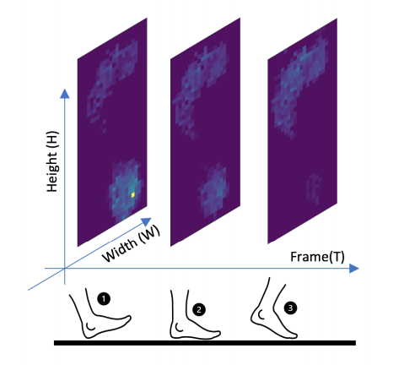
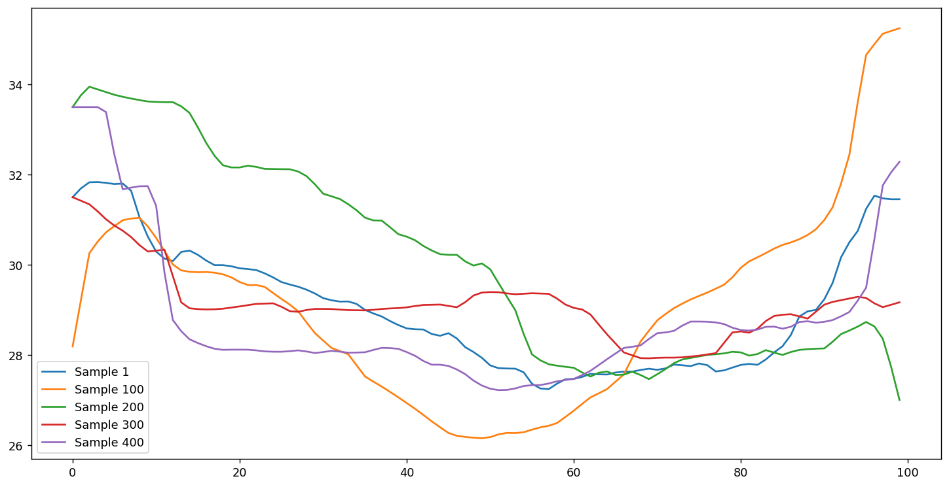
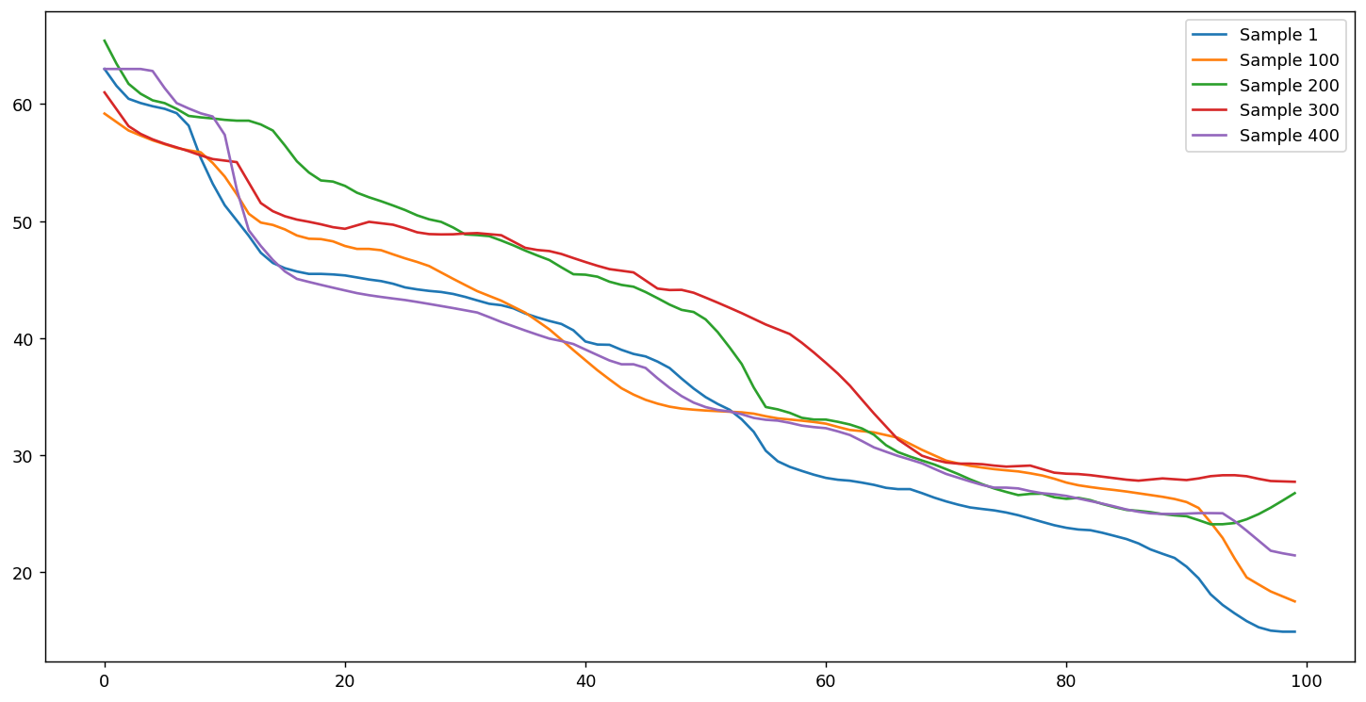
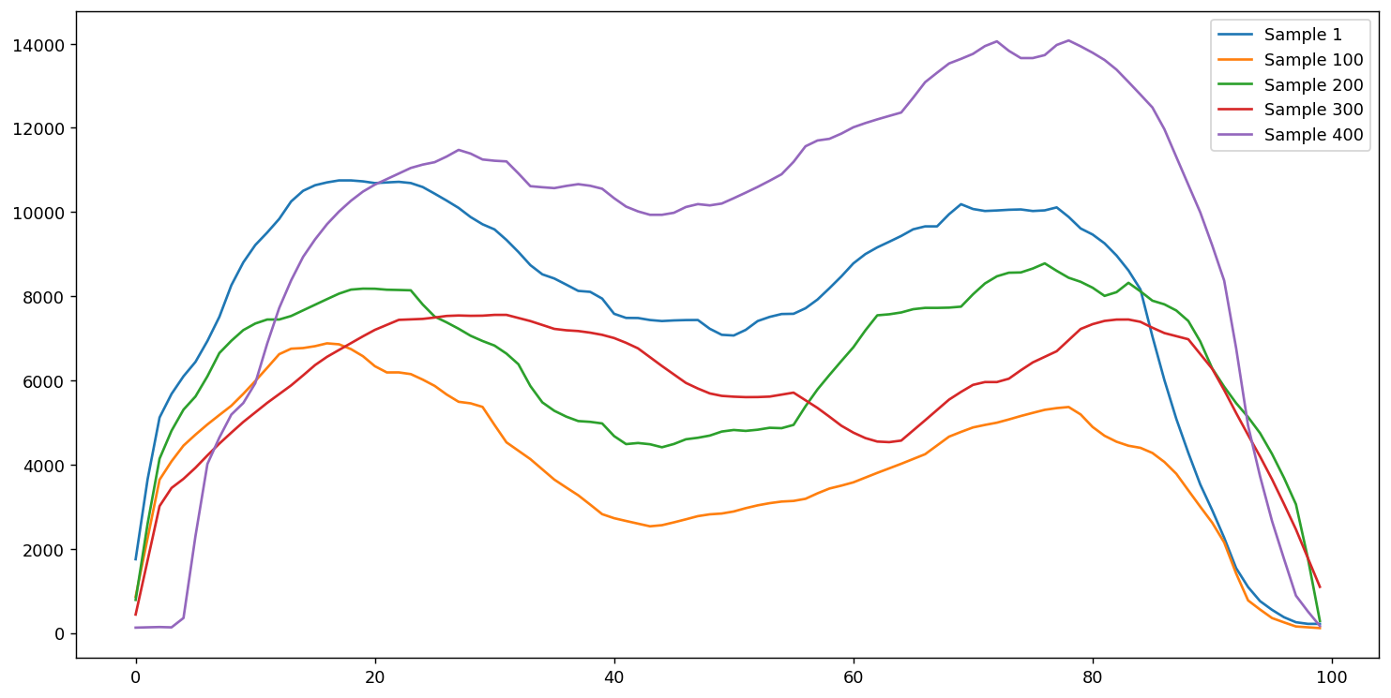
convert a video data to time series.
Extracting 4 features from each frame
Track those features in each frame
Achieving four 2D time series dataset
Notes:
As mentioned, my goal is do classification on time series data and
,,,,,,,since the nature of Stepscan data set is,,,,,,,,, a video-based data ,,,,,,,,, So I needed to convert it to a time series data.
For this purpose,,,,,,,,, I’ve tracked ,,,,,,,,,the values of max pressure, average pressure, ,,,,,,,,,along with The X and Y position of COP,,,,,,,,,over each frame,,,,,,,,, and finally, four time-series ,,,,,,,,,have been prepared and now we can extract features from this data set
Here you can see these four time series data

Slide 6
Feature Extraction and Selection
Two different approaches were used for feature extraction:
Handcrafted features
Extraction of 4 groups of features
Autoregressive coefficients Features
Temporal Features
Spectral Features
Statistical Features
low variance and high-correlated features were deleted
Deep learning features
Used pre-trained CNN to extract features automatically
Notes:
I did feature extraction by two methods,,,,,,,,,,
handcrafted features ,,,,,,,,, which was done manually and ,,,,,,,,,
Deep learning methods,,,,,,,,, which was done automatically .
I extracted 4 groups of features. named Temporal features, ,,,,,,,,, Spectral features, ,,,,,,,,, statistical features ,,,,,,,,,and Autoregressive coefficient features.
THEN in order to reduce the complexity of our model,,,,,,,,, , I did some basic feature selection such as removing low variance and high-correlated attributes

Slide 7
Machine Learning Approaches
Implemented several (LDA, KNN, SVM, RFC)
20% percent of samples were set aside for testing the classifier,
The rest was divided into 10-fold cross-validation for evaluation and training.
The grid search were implemented to find the best hyper-parameters.
knnspace = {
"model__n_neighbors": np.arange(1, 22, 2),
"model__metric": ["euclidean", "manhattan", "chebyshev"],
"model__weights": ["distance", "uniform"],
"sfs__k_features": [100, 200, 300]}
svmspace = {
"model__probability": [True],
"model__kernel": ["rbf", "linear"],
"model__decision_function_shape": ["ovr", "ovo"],
"model__C": [0.1, 10, 1000],
"model__gamma": [1, 0.01, 0.0001],
"model__random_state": [seed],
"sfs__k_features": [100, 200, 300]}
treespace = {
"model__max_depth": np.arange(3, 33, 2),
"model__criterion": ["gini", "entropy"],
"sfs__k_features": [100, 200, 300]}
Notes:
After extracting features,,,,,,,,, now I implemented several classifiers, named LDA , KNN, SVM, Random forest to do classification.
So firstly, I set aside 20 percent of data for testing part and others was divided into 10-fold cross-validation set for evaluation and training, I am going to talk more about this step in the future.
Also for tuning hyperparameter. I did grid search
These three dictionaries show ,,,,,,,,,,my space search ,,,,,,,,,,,,,for kNN, SVM, and tree algorithms
before talking about the results, let look at the deep learning approaches
Holdout

Slide 8
Deep learning algorithms
Feature engineering requires domain knowledge
Deep learning uses neural networks to automatically learn what attribute of the data are important
There are many architectures for time series deep learning:
LSTM
CNN-LSTM
ConvLSTM
Fully Convolutional Networks (FCN)
Echo State Networks (ESN)
Most architectures are used for time series data
 | Machine learning | Deep learning
Size of raining data set | Small | Large
Feature Extraction | Yes | No
Debugging | Easy | Hard
Training Time | Short | long
Notes:
well, Another method that I have used for this project called deep learning
As we saw in the couple last slides, ,,,,,,,the extracting meaningful features ,,,,,,,is one of the challenging tasks,,,,,,,,,, in conventional machine learning approaches. Therefore,,,,,,, Deep learning could be a good solution. ,,,,,,,,,For using this networks ,,,,,,,, we need a large number of training set as well as a Significant computational resources for training.
As you can see, these are Some of Deep neural networks that are Mostly used for time series data

Slide 9
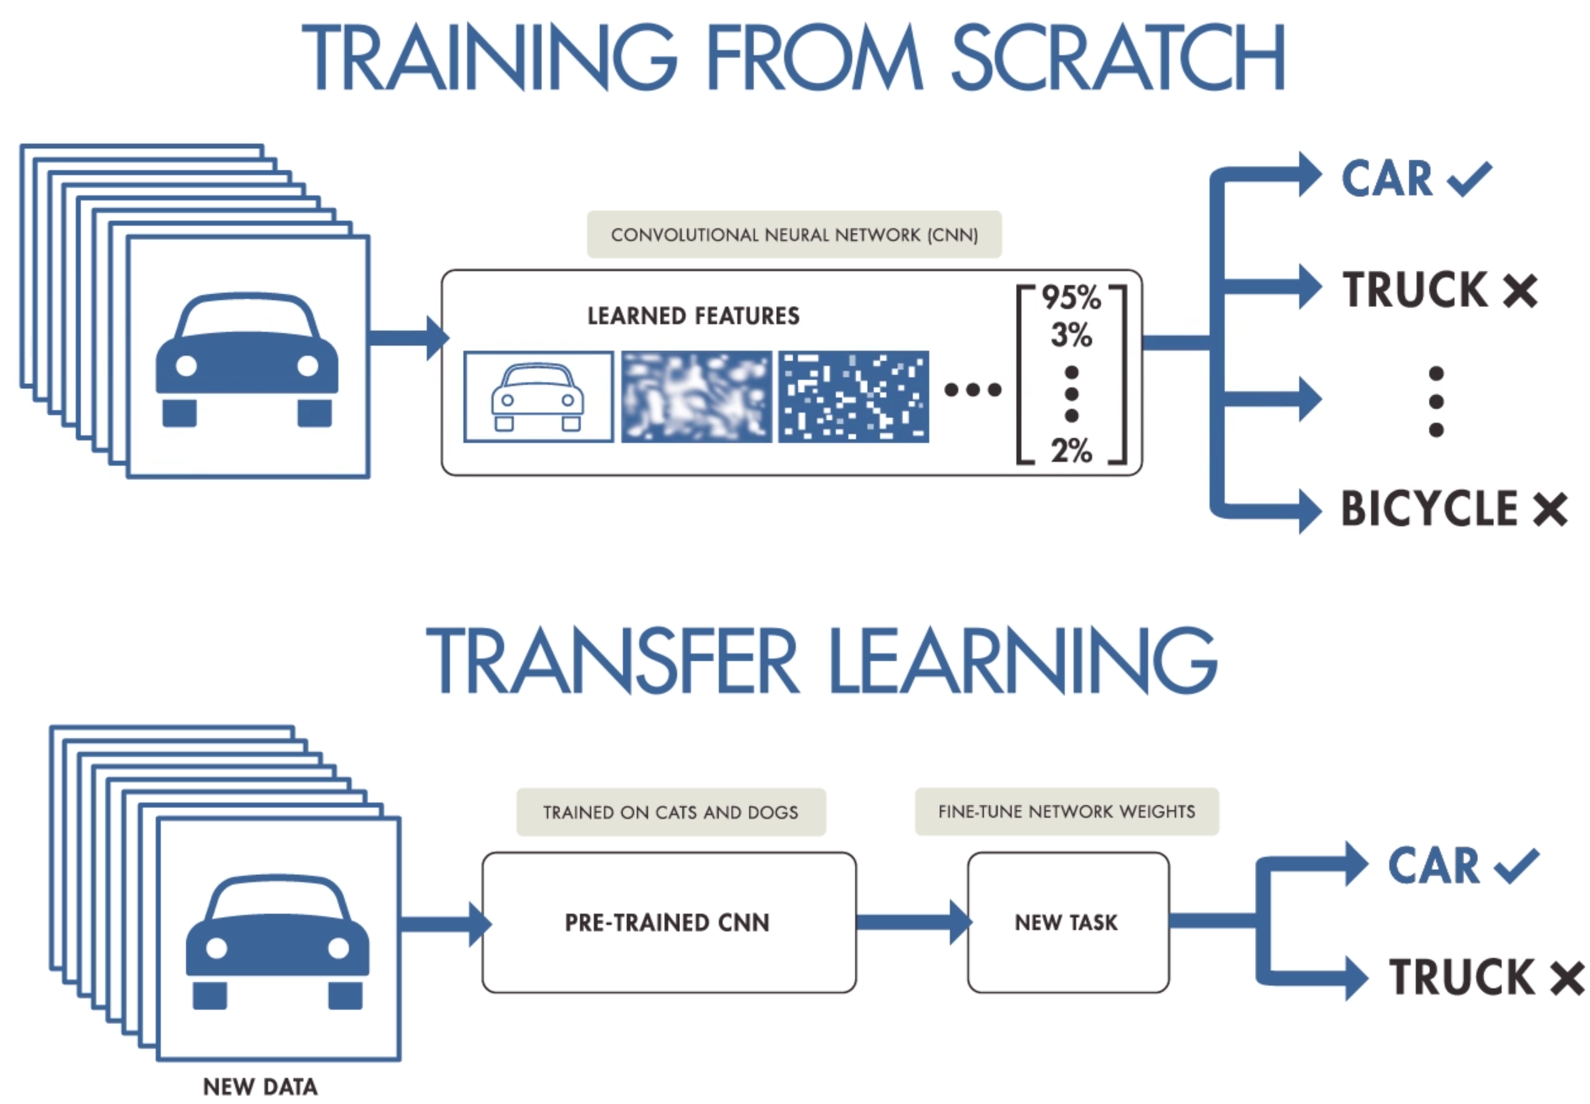
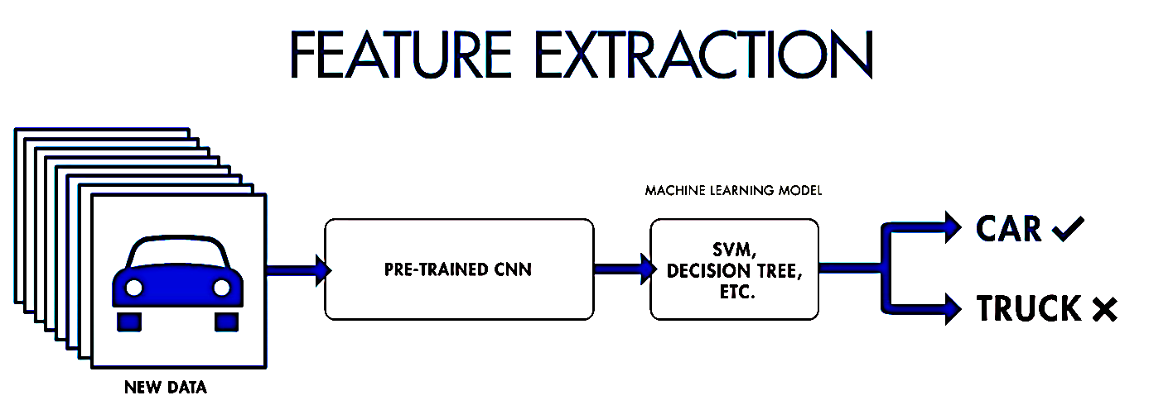
Deep learning algorithms
1
2
3
Notes:
well, how can we use these networks?
there are three ways to use deep learning in general.
The first method is to train the network totally based on our data. ,,,,,,,,,,,,,This approach is highly accurate.
But it’s not practical for problems that have a small dataset,
The second method relies on transfer learning,,,,,,,,,,,,,,, in this method we can use a pre trained networks ,,,,,,,,,,,,,,,,,,,,,,to solve a similar problem.
This method is mostly used for image data
With the third method,,,,,,,,,,,,,,,,,,,, we can use a pre-trained network ,,,,,,,,,,,,,,,,as a feature extraction block and
Use another Machine learning method for classification.
In the next two slides,,,,,,,,,,,,,, I am gonna go deep in,,,,,,,,,,,, the implemented algorithms

Slide 10
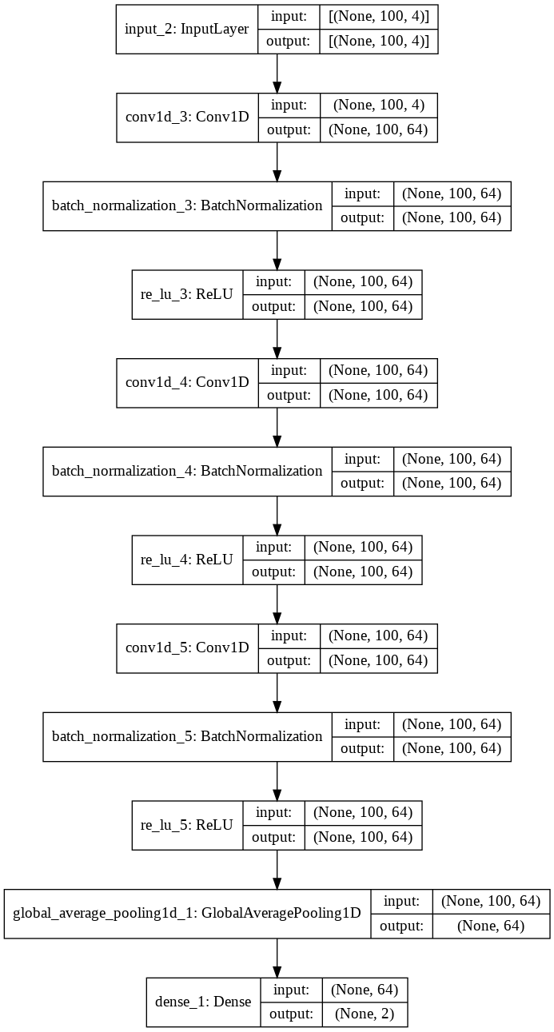
end-to-end method
We also implemented DNNs as end-to-end networks (FCN)
This network has three blocks.
Each block is a convolutional layer followed by a batch normalization and a ReLU activation layer.
Hyper-parameters:
epochs = 200
batch_size = 32
optimizer="adam”
loss="sparse_categorical_crossentropy"
For each block: we have 64 filters with size=3
Trainable params: 26,050
Notes:
Here is the first one ,,,,,,,,,,,,,,which I have implemented a Fully Convolutional Networks (FCN)
As you can see ,,,,,,,,,,,,this network has three blocks.
And,,,,,,,,,,,Each block has a convolutional layer along with a batch normalization and a ReLU activation layer.
Also ,,,,,,,,,,,I am gonna put emphasis on ,,,,,,,,,,,,,,,,,,the training parameter that is about 26_000

Slide 11
Transfer learning method
Implemented LDA, kNN, SVM, and RFC.
Ricker wavelet (“Mexican hat wavelet”) was used.
Compared 2 CNN architectures ImageNet for pre-training the CNN (VGG16, and MobileNet)
The size of testing data was considered 20%
Model* | Image size | Weighted size | Length of features | Learning parameters | Number of layers
VGG16 | 224 x 224 | 535 MB | (1, 4096) | 138,357,544 | 23
MobileNet | 224 x 224 | 17 MB | (1, 1024) | 4,253,864 | 88
* https://github.com/SKazemii/EE6563,
Notes:
As the second way, I also used transfer learning method,
In this frame work I used wavelet to convert time series to 2D-scalogram
I have used two CNNs,,,,,,,,,,,,, VGG16 and Mobilenet ,,,,,,,,,,,,,,,to extract the features and then,,,,,,,,,,,, implemented four machine learning algorithms,,, to classify the samples.
As mentionned,,,,,,,,,,,,,,,,,,, our dataset is not enough to train a deep network. ,,,,,,,,,,,,,,,,,,,,,,,,,,For example,,,, we have at least 4 million learning parameters in VGG16, whereas our dataset has less than 2 000 samples
furthermore, ,,,,,,,,,,These frameworks were implemented in python by using the Keras and scikit learn package, ,,,,,,,,,,,,and the codes are available ,,,,,,,,,,,on the GitHub repository.
for this reason ,,,,,,,,,,,we downloaded these parameters from the ImageNet website.

Slide 12
The pipeline of implemented algorithms
Conventional ML algorithms
Features Extracting
Feature Selection
SVM, kNN, LDA, RFC
Calculating Accuracy
Video base dataset
Conventional
ML algorithms
Transfer learning approach
Converting to time series
Wavelet Transform (CWT)
VGG16
MobileNet
SVM, kNN, LDA, RFC
Calculating Accuracy
Transfer
learning
End-to-end Method
Fully Convolutional Networks (FCN)
Calculating Accuracy
End-to-end
Method
Notes:
To recap, we used three different frameworks
In the first framework,,,,,,, we extracted handcrafted features and fed to four different algorithms
In the second one,,,,,,,,,,,,, we used Wavelet transform to convert each time series to image and then ,,,,,,,,,,,,,,,extracted features automatically by two pre-trained networks VGG16 and MobileNet
And finally, ,,,,,,,,,,,,,,,,,,,a Fully convolutional networks were used for classification

Slide 13
Test scenario
50 Known Users
30 Stranger Users
50 binary models
Training set
Test set
Imposter set
16 samples
(in-class)
4 samples
(in-class)
20 *30 samples
(out-class)
≈200
16 *49 samples
(out-class)
≈800
4 *49 samples
(out-class)
≈200
*Train/Test Split 80/20​
** StratifiedKFold =10
Notes:
So before seeing results lets,,,,,,,,,,, talk more about the test scenario
As mentioned, ,,,,,,,,,,, we have 80 different users in the Stepscan dataset ,,,,,,,,,,, each user has about 20 samples,
I've separated ,,,,,,,,,,,the first 50 users ,,,,,,,,,,,as our training and testing dataset ,,,,,,,,,,,and other 30 users as a Stranger data set,,,,,,,,,,,,
Since our problems is verification, I've developed 50 binary classifier for each user
Now for each model, ,,,,,,,,,,,I've used 80 present of light green dataset ,,,,,,,,,,,in 10-fold cross validation set for training.
As you can see, ,,,,,,,,,,, the dataset is an unbalance dataset. ,,,,,,,,,,, Therefore, I've used StratifiedKFold ,,,,,,,to keep the same percentage of each class ,,,,,,,,,,,,,,in each fold.
In the rest of this presentation, ,,,,,,,,,,,I will report the result of test set

Slide 14
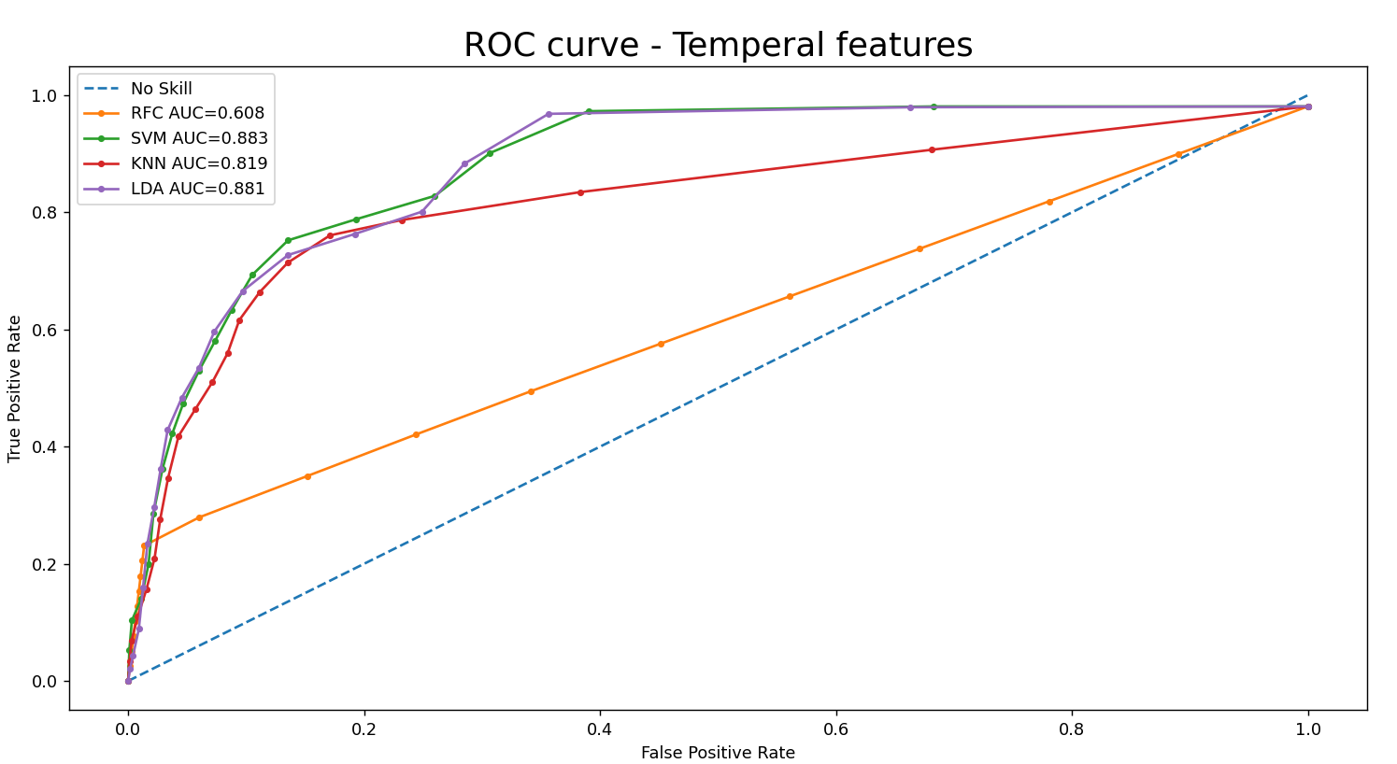
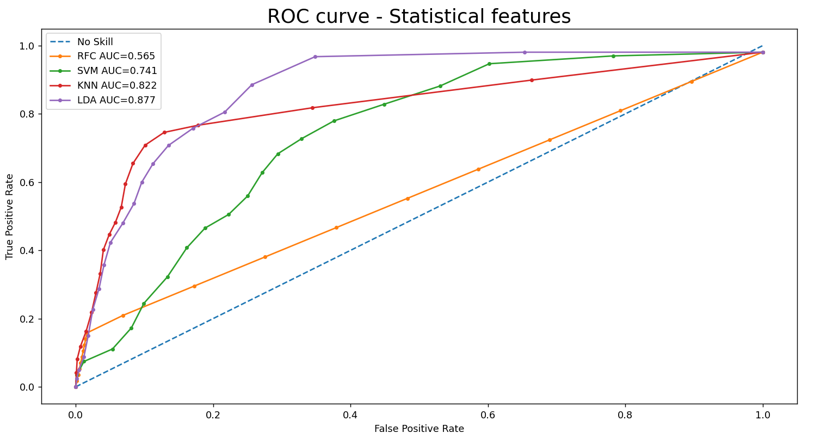
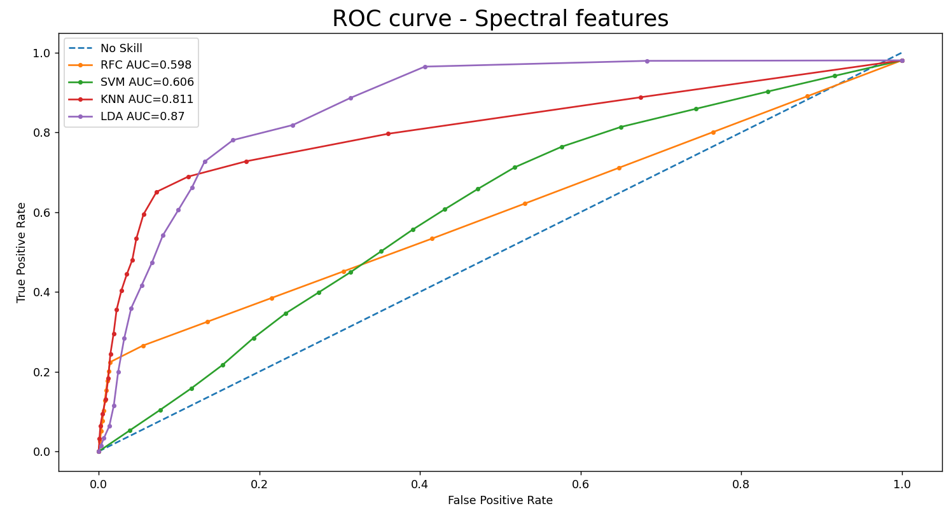
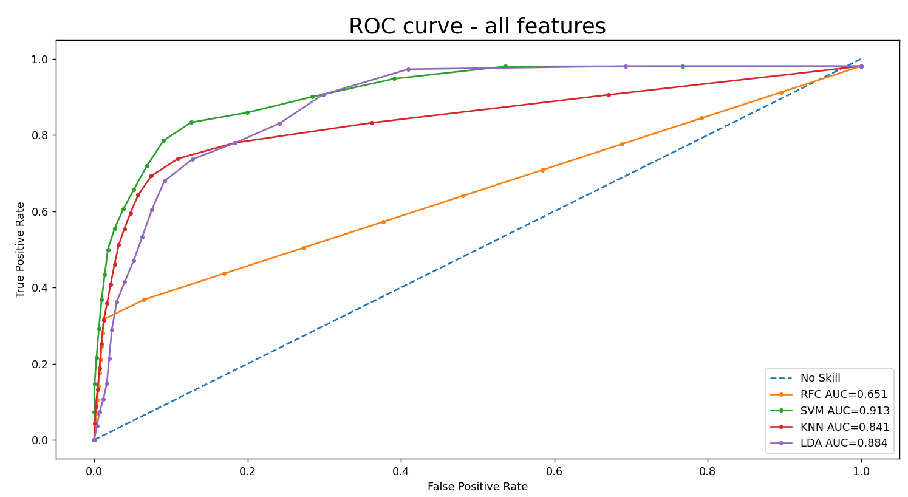
Results and Discussion
Notes:
As mentioned,,,,,,,,I've extracted 4 categories of features and here we can see the performance the ML algorithms,,,,,,,,,, on these features by ROC curve metric
ROC curve ,,,,,,,,,,is a graph showing ,,,,,,,,,,the performance of a classification model. ,,,,,,,,,, This curve is based on
True Positive Rate
False Positive Rate
another metrics here is AUC ,,,,,,,,,,that stands for "Area under the ROC Curve.
So the bigger area ,,,,,,,,,,indicates the better performance . As you observe,,,,,,,,,, all MLs show the better performance in the last graph which is related to combination of all features.

Slide 15
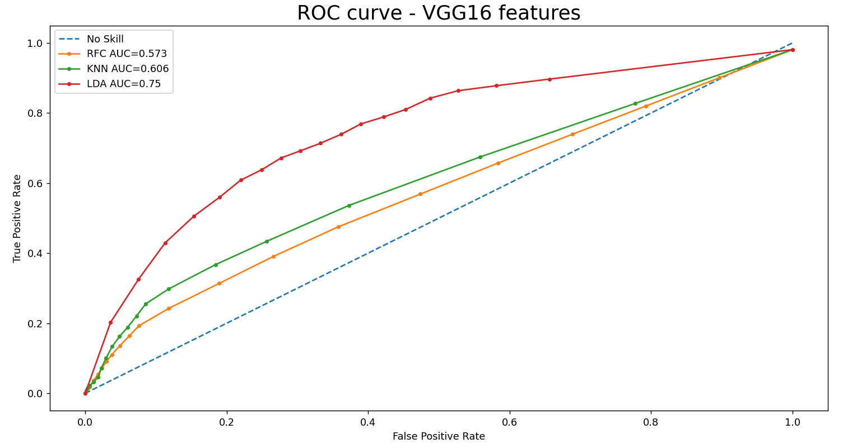
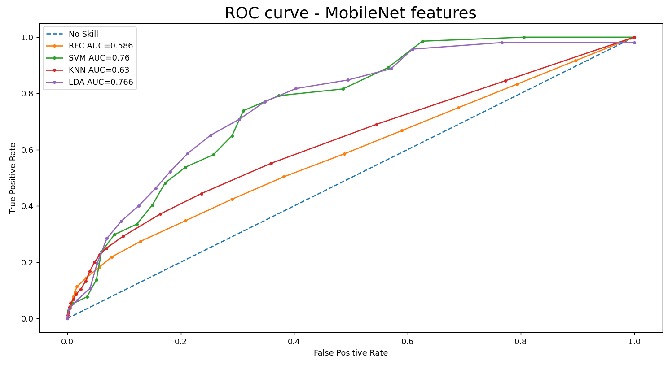
Results and Discussion
Notes:
here are ROC curve for features that were extracted by vgg16 and MobileNet
LDA had the best performance among other algorithms

Slide 16
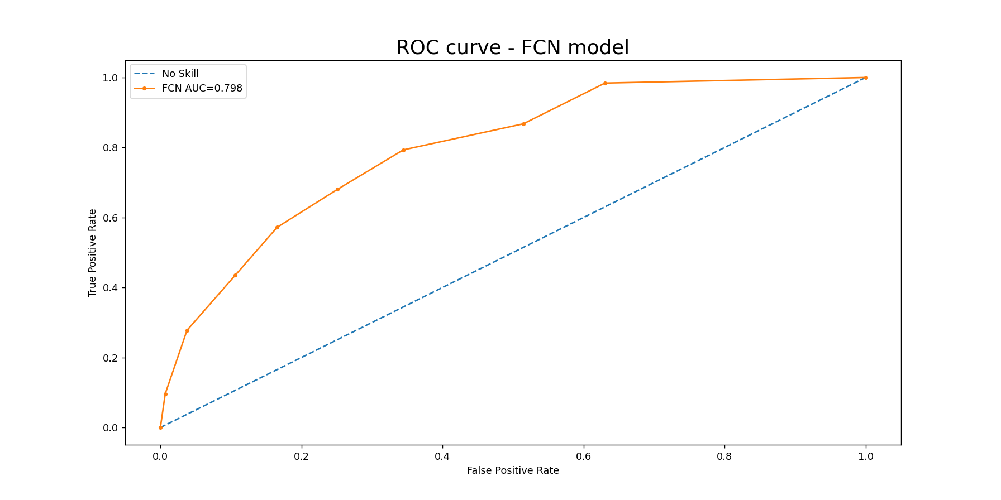
Results and Discussion
Notes:
Fully Convolutional network was the third way which was done automatically …...Now let compare all the results of auc in the next slide

Slide 17
Results and Discussion-AUC
Conventional ML algorithms |  | LDA | SVM | KNN | RFC
 | Temporal Features | 0.881 | 0.883 | 0.819 | 0.608
 | Spectral Features | 0.870 | 0.811 | 0.606 | 0.598
 | Statistical Features | 0.877 | 0.822 | 0.741 | 0.565
 | All Features | 0.884 | 0.913 | 0.841 | 0.651
Transfer learning |  | LDA | SVM | KNN | RFC
 | MobileNet Features | 0.766 | 0.760 | 0.630 | 0.586
 | VGG16 Features | 0.750 | - | 0.606 | 0.573
End-to-end Method |  | FCN
 | Automatic Features | 0.798
Notes:
Here you can see all three frameworks….
As mentioned, the larger AUC, indicates the better performance
LDA had the better performance on statistical and spectral features and pre trained CNNs,,,,,,,
while svm did better on temperal.
svm achieved the best result on combination of all handcrafted features
surprisingly, fully convolutional networks did not have the best performance among other frameworks
If we focus in the conventional method we see that SVM in temporal features did the best , LDA in spectral and statistical had the highest performance. And the interesting point is that all features had the highest performance in the forth row which is related to combination of all features.......
Now look at the second way which we implement VGG16 and mobile net on extracted features and show that LDA performed better that the remaining algorithms.
The third one is related to FCN which had the performance of 0.798
Although we do not use a perfect DNN, the result of networks are not good as much as conventional neural network

Slide 18
Results and Discussion- EER
Conventional ML algorithms |  | LDA | SVM | KNN | RFC
 | Temporal Features | 0.215 | 0.203 | 0.222 | 0.438
 | Spectral Features | 0.193 | 0.412 | 0.228 | 0.441
 | Statistical Features | 0.206 | 0.306 | 0.206 | 0.465
 | All Features | 0.202 | 0.147 | 0.202 | 0.402
Transfer learning |  | LDA | SVM | KNN | RFC
 | MobileNet Features | 0.298 | 0.286 | 0.404 | 0.452
 | VGG16 Features | 0.306 | - | 0.418 | 0.453
End-to-end Method |  | FCN
 | Automatic Features | 0.285
Notes:
in this slide, we compare EER of all frameworks
Eer stands for Equal error rate (EER)
And indicates a point where that the FAR (False Acceptance Rate) and FRR (False Rejection Rate) is equal.
the smaller EER, shows the Better performance
As you see, SVM has the smaller value on combination of all handcrafted features.

Slide 19
Thank you
Question?
Notes:
Thank you very much for your attention
I am open to any questions

